Slide 1
Revenue Management and Price Optimization

Slide 2
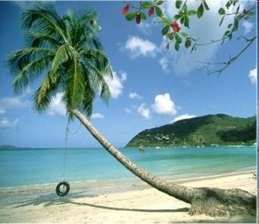



Slide 3
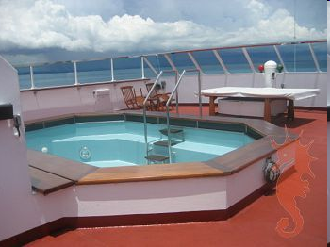

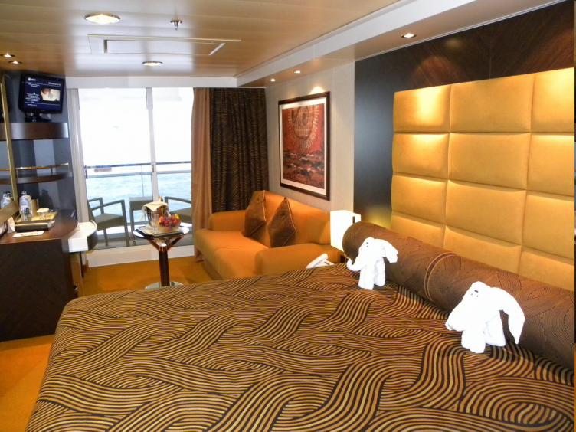
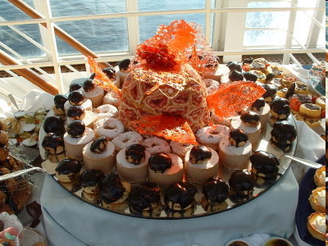

5-Day, 2-People, All-Inclusive, Luxury Cruise to Exotic Island
You need a price for 2 for all 5 days
Don’t show anyone

Slide 4
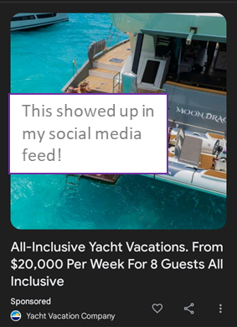
Key Take-Aways from the Game?
What were your key lessons/comments from the game?
My objectives with the game
Introduce the topic and introduce it in a way that showed you the excitement and importance of the field
Show a case where changing the price was just guessing
And, provide Game 3 to show where revenue management can become difficult
Question I’ve had in the past: Why didn’t I create the “market”
Some fun facts about real luxury cruises
High end luxury cruise lines have Michelin restaurants, exclusive wine, expensive alcohol…
12-day Alaska cruise, best suite: $25K (for 2)
128 day cruises where a couple could spend $700K
For some trips, you just need one big spender to make the trip worthwhile
Hard to segment customers– all are leisure
And, no overbooking because no other cruises going out

Slide 5
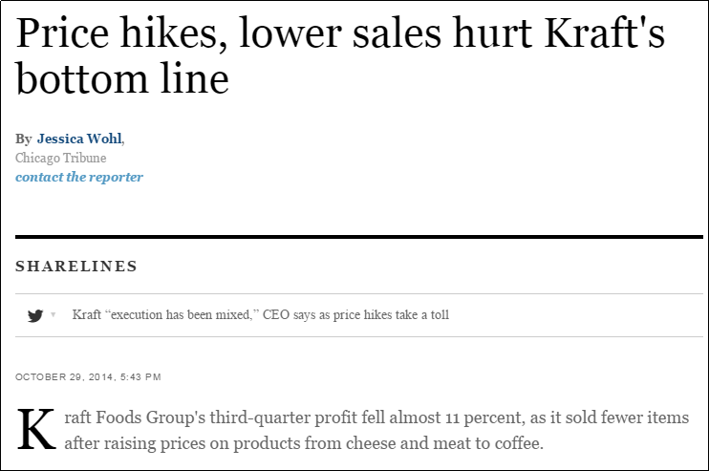
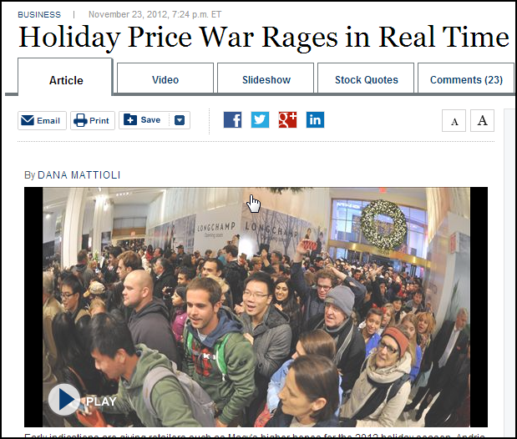
Pricing is an interesting field
It touches all of us
Experience at small software company
Start-up, self funded, by far, pricing caused the most fights and most emotion
What was our trade-off in pricing?
Too high? Too low?
Becoming more real-time

Slide 6
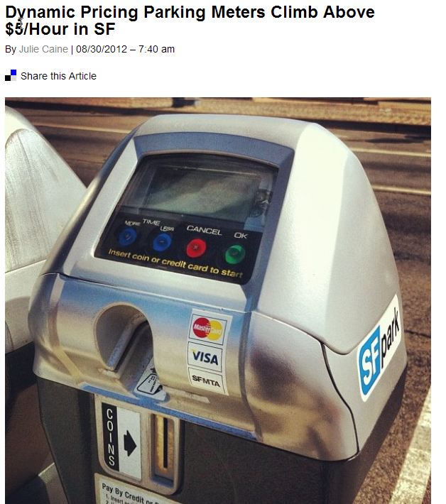

Examples of Revenue Management Popping Up Everywhere

Slide 7
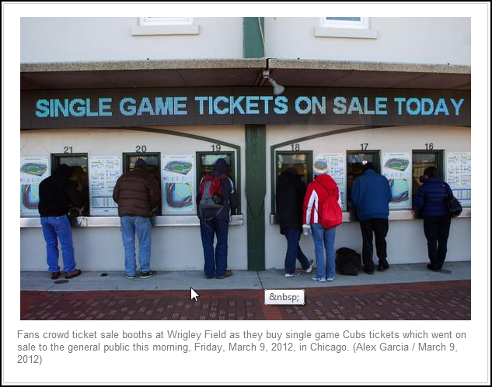
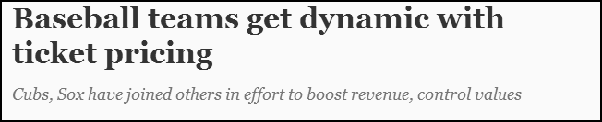
Examples of Revenue Management Popping Up Everywhere
Source: http://www.chicagotribune.com/business/ct-biz-0512-stub-hub--20130512,0,3675593.story

Slide 8
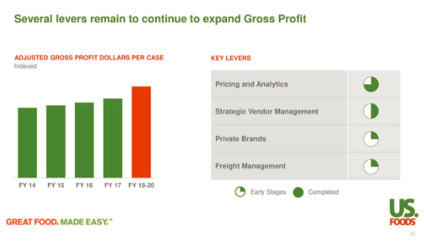
US Foods Sees Pricing as a Key Advantage
https://seekingalpha.com/article/4157154-us-foods-usfd-investor-presentation-slideshow

Slide 9
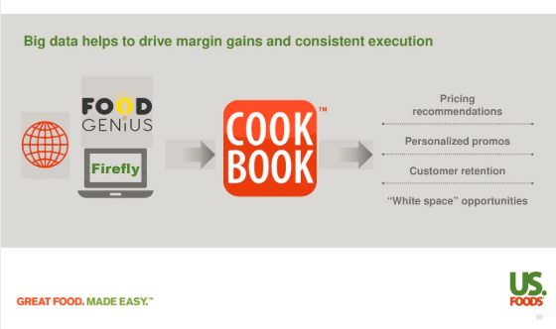
US Foods Sees Pricing as a Key Advantage
https://seekingalpha.com/article/4157154-us-foods-usfd-investor-presentation-slideshow

Slide 10
Revenue Management
Pricing tools– how does demand change with prices
Forecasting tools– what is the expected demand
Inventory tools– how much inventory to make available
Yield management– how much to allocate to different groups (this is what you did in Game 3)

Slide 11
Price Optimization
What is it?
“Price optimization is the use of mathematical analysis by a company to determine how customers will respond to different prices for its products and services through different channels” (Wiki)
Approach developed for industries such as Retail
Each product is made available at a single price to a cohort of customers with different “willingness to pay”.
Goal to maximize revenue or margin by finding optimal price to charge the overall market in order to maximize return
How it works?
Quantity Demanded or Share is estimated/modeled as a function of price or markup
Price becomes the decision variables
Out of market pricing usually through conjoint analysis (is a survey-based statistical technique used in market research that helps determine how people value different attributes that make up an individual product or service)
Key consideration
Cost allocation uncertainty
Cost volatility
Margin rate, margin dollar, volume and sales trade-off

Slide 12
Pricing Models- Advanced (Not covered in class)
Pricing models are usually constructed as a parametric model
Simple initial setup, yet takes extensive time to improve even marginally
Coefficient are very important (really important), so are the residuals (~errors).
Multicollinearity (variables that are highly correlated with each other) shall be dealt with (usually with manual variable selection rather than Lasso or similar)
Correlation matrix is closely reviewed (manually drop one of the highly correlated covariates)– Season and Temperature
Variance inflated factor (VIF) * stats commonly studied (VIF<~4 unless otherwise concluded based on model stats)

Slide 13
Pricing Models- Advanced (not covered in class)
Commonly included covariates (B2B differs from B2C, by channel type, and by industry)
Own price or markup, Competitor price
Own price other items/category average (cannibalization possibility)
Marketing mix (promo price, advertisement, etc.)
Assortment and Pricing cohort (modeled separately)
Demographics and macro econ stats
Competitor count and distance
Trend and seasonality
Customer life cycle stage and retention risk (Customer centric)
Cost to serve and contribution margin (modeled separately)

Slide 14
Pricing Models Formulation
Log Linear model (Semi-log Model )
Model ln(Q) as a function of untransformed predictor variables
Q = e ^{(ß0 + ß1P1 + ...+}ᵋ⁾

Slide 15
Optimal price
Optimal price (based on profitability) can then be assessed:
Price Quantity Revenue Cost Gross Profit
$10 5 $10 * 5 = $50 $20 * 5 = $100 $50 - $100 = ($50)
$20 4 $20 * 4 = $80 $20 * 4 = $80 $80 - $80 = $0
$30 3 $30 * 3 = $90 $20 * 3 = $60 $90 - $60 = $30
$40 2 $40 * 2 = $80 $20 * 2 = $40 $80 - $40 = $40 *
$50 1 $50 * 1 = $50 $20 * 1 = $20 $50 - $20 = $30
True Cost is often extremely difficult/impossible to allocate at a granular level.
Often companies optimize for revenue and apply business rules to achieve financial targets
Carefully designed Pricing test is usually required to observe customer price sensitivity
Price Quantity Revenue Cost Gross Profit
$10 5 $10 * 5 = $50 $20 * 5 = $100 $50 - $100 = ($50)
$20 4 $20 * 4 = $80 $20 * 4 = $80 $80 - $80 = $0
$30 3 $30 * 3 = $90 $20 * 3 = $60 $90 - $60 = $30
$40 2 $40 * 2 = $80 $20 * 2 = $40 $80 - $40 = $40
$50 1 $50 * 1 = $50 $20 * 1 = $20 $50 - $20 = $30

Slide 16

Pricing Tools and Forecasting– We’ll Summarize this 1-hour presentation
Source for this section, Talk by David Simchi-Levi
https://www.youtube.com/watch?v=n1upFDGRdfc

Slide 17
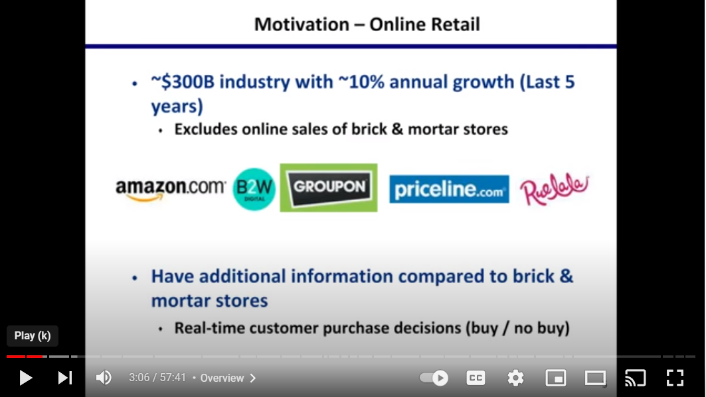
Source for this section, Talk by David Simchi-Levi https://www.youtube.com/watch?v=n1upFDGRdfc

Slide 18
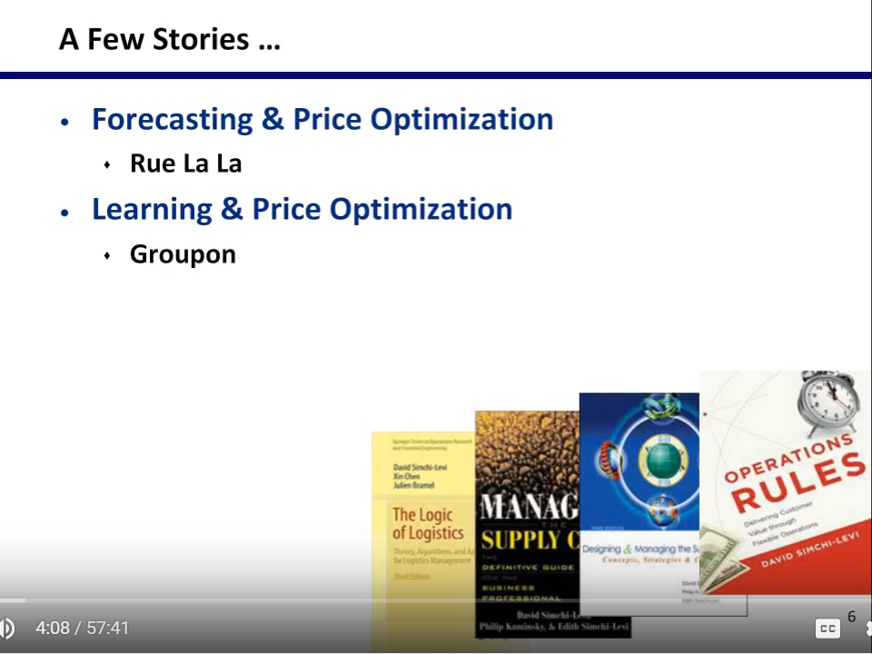
Source for this section, Talk by David Simchi-Levi https://www.youtube.com/watch?v=n1upFDGRdfc

Slide 19
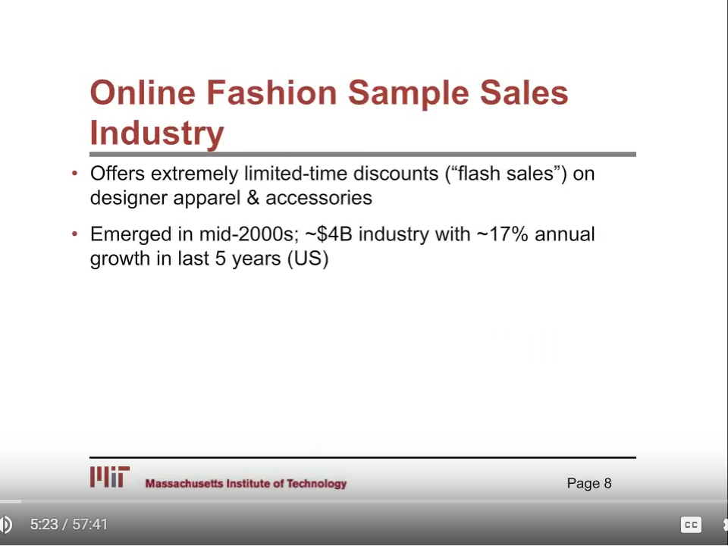
Source for this section, Talk by David Simchi-Levi https://www.youtube.com/watch?v=n1upFDGRdfc

Slide 20
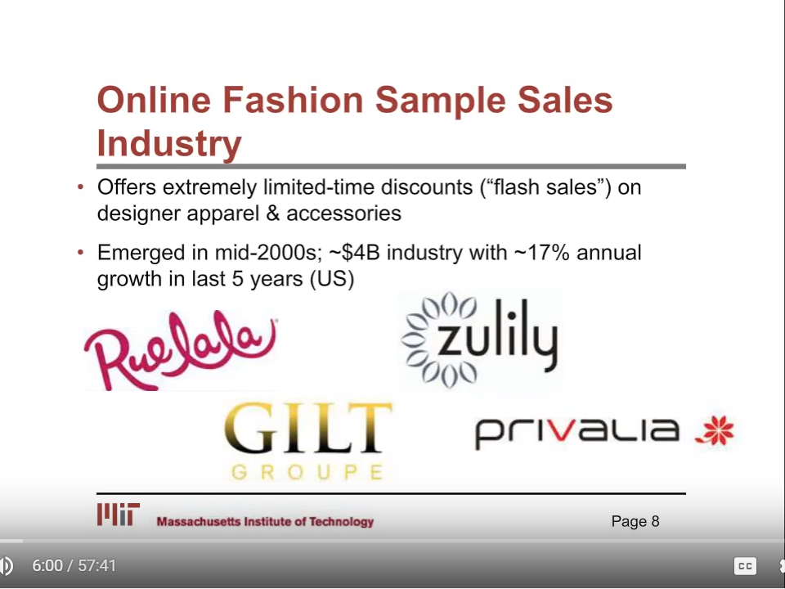
Source for this section, Talk by David Simchi-Levi https://www.youtube.com/watch?v=n1upFDGRdfc

Slide 21
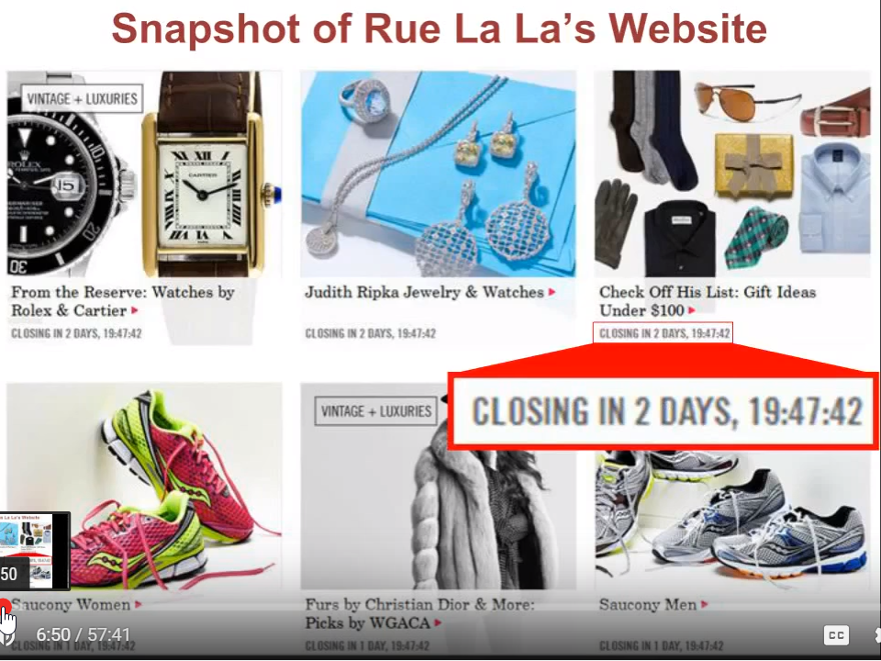
Source for this section, Talk by David Simchi-Levi https://www.youtube.com/watch?v=n1upFDGRdfc

Slide 22
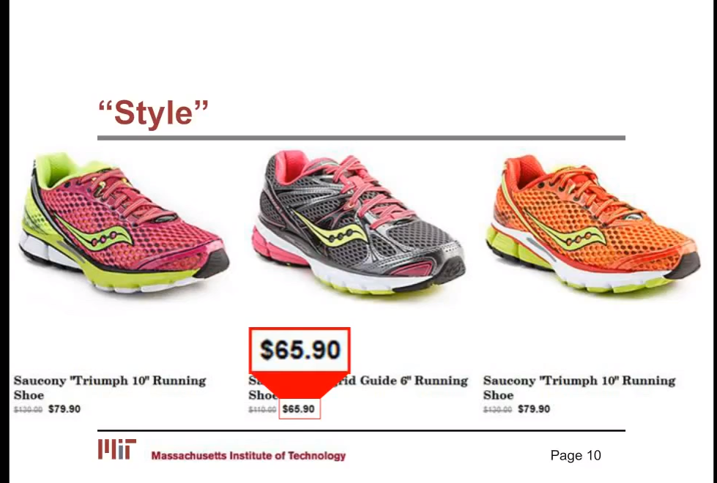
Source for this section, Talk by David Simchi-Levi https://www.youtube.com/watch?v=n1upFDGRdfc

Slide 23
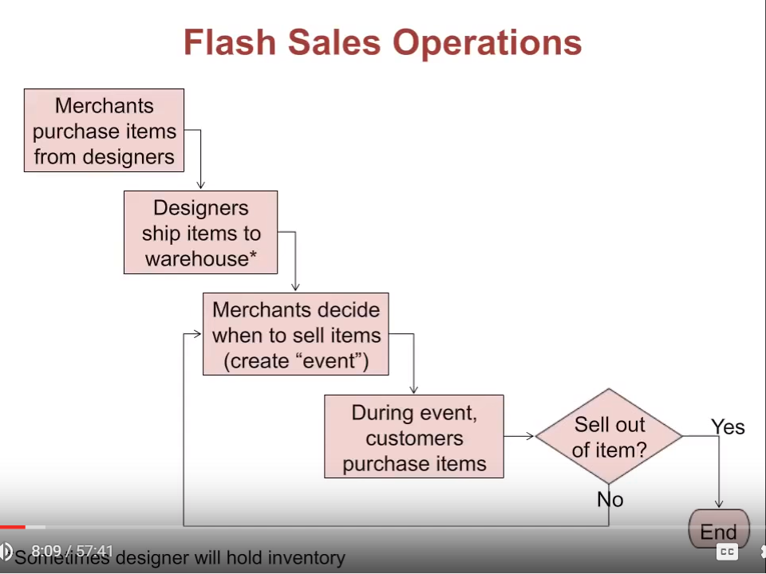
The project started out as an inventory problem…
They figured out it was a pricing (and forecasting) problem
Inventory and pricing are related
Source for this section, Talk by David Simchi-Levi https://www.youtube.com/watch?v=n1upFDGRdfc

Slide 24
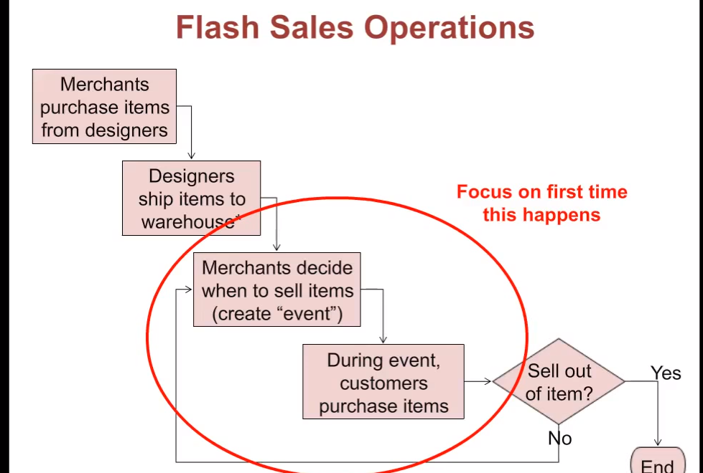
Source for this section, Talk by David Simchi-Levi https://www.youtube.com/watch?v=n1upFDGRdfc

Slide 25
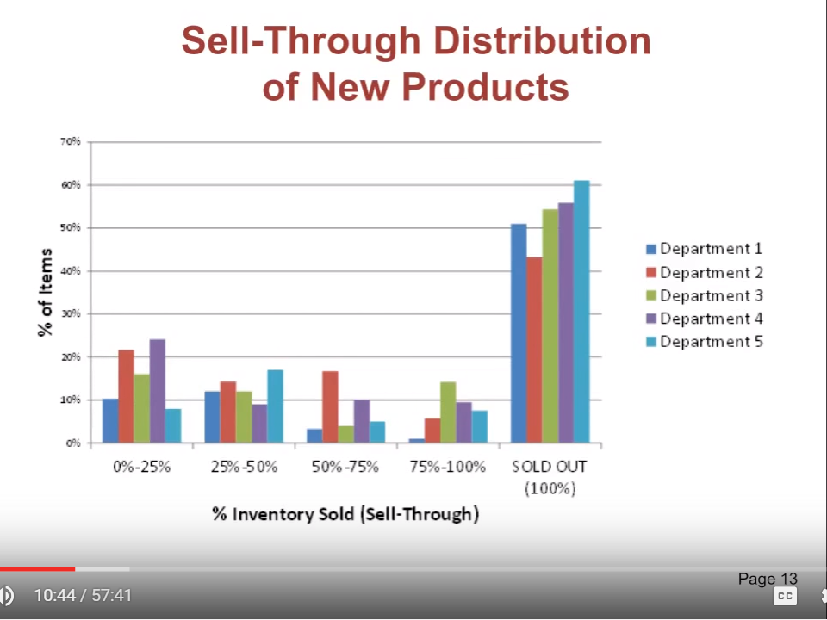
Source for this section, Talk by David Simchi-Levi https://www.youtube.com/watch?v=n1upFDGRdfc

Slide 26
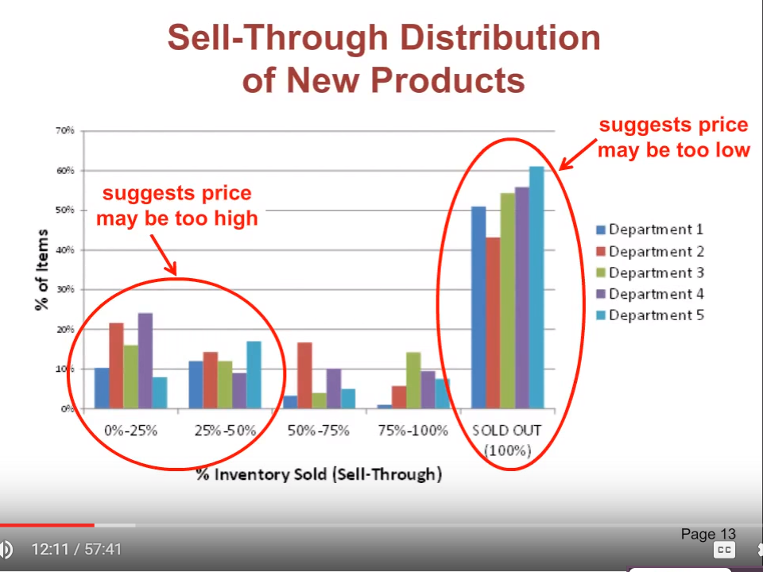
Source for this section, Talk by David Simchi-Levi https://www.youtube.com/watch?v=n1upFDGRdfc

Slide 27
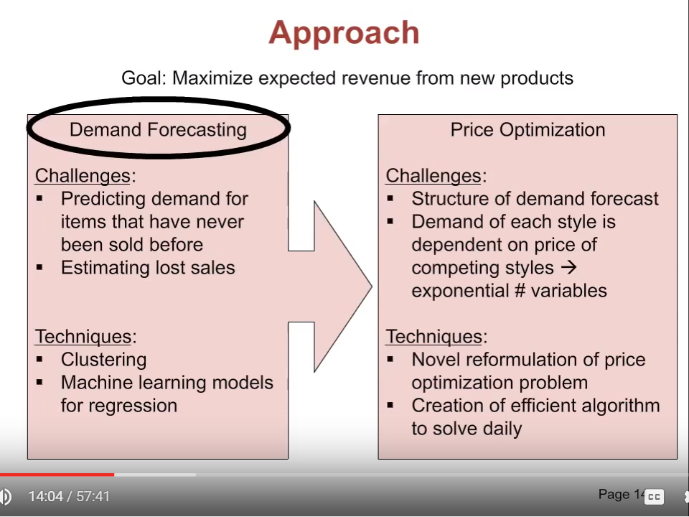
When you sell out, you have data on sales, not on demand… need other information
Source for this section, Talk by David Simchi-Levi https://www.youtube.com/watch?v=n1upFDGRdfc

Slide 28
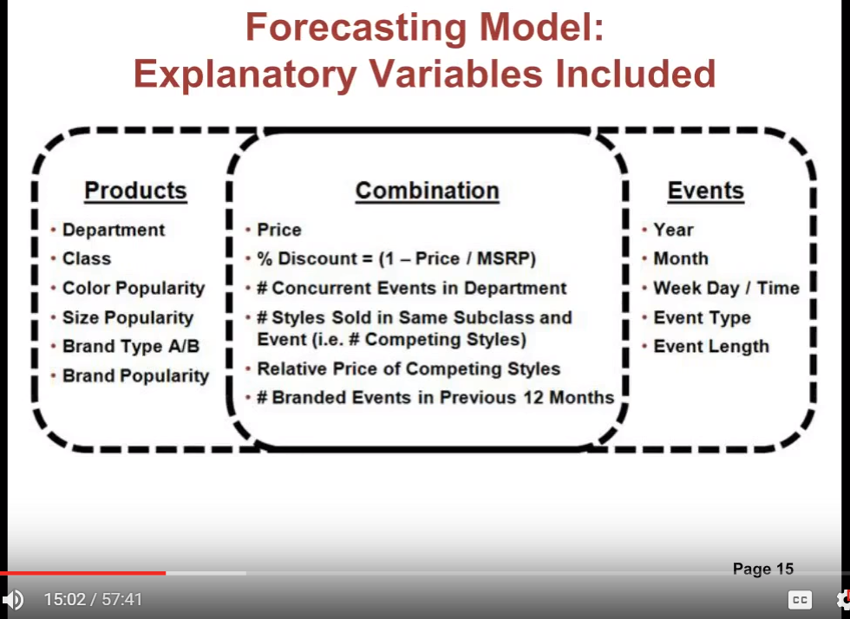
Source for this section, Talk by David Simchi-Levi https://www.youtube.com/watch?v=n1upFDGRdfc

Slide 29
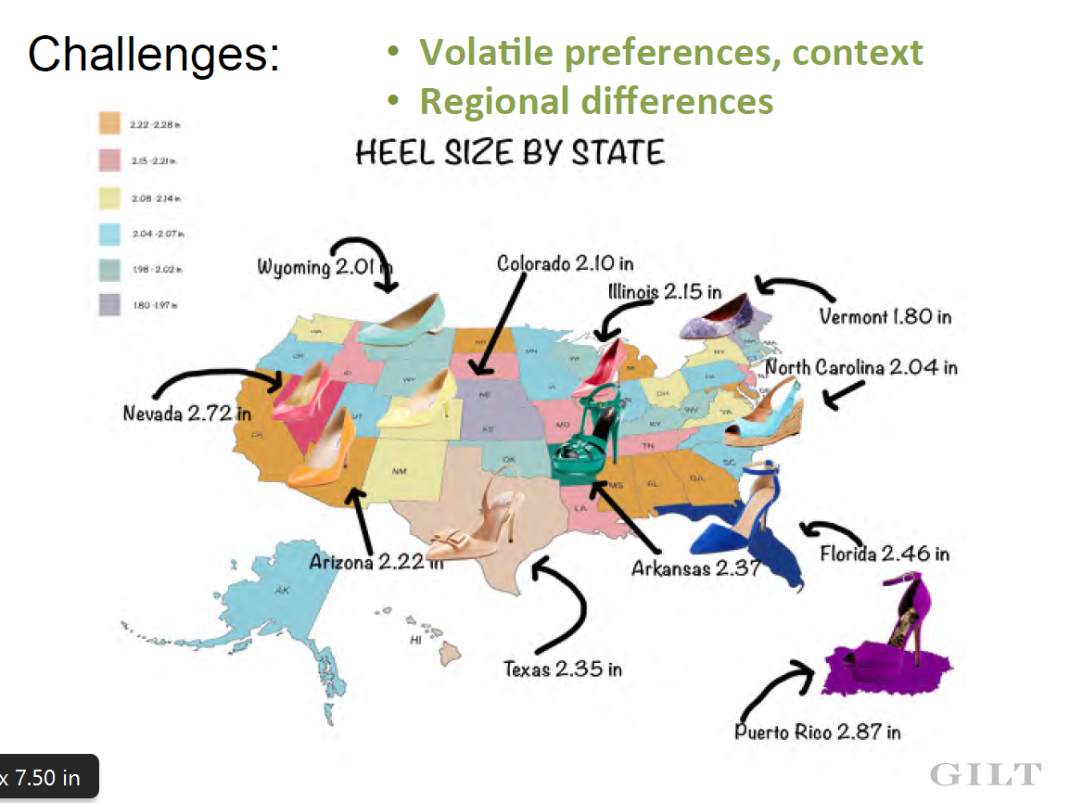
Example from another Flash Sale Retailer

Slide 30
Example from another Flash Sale Retailer

Slide 31
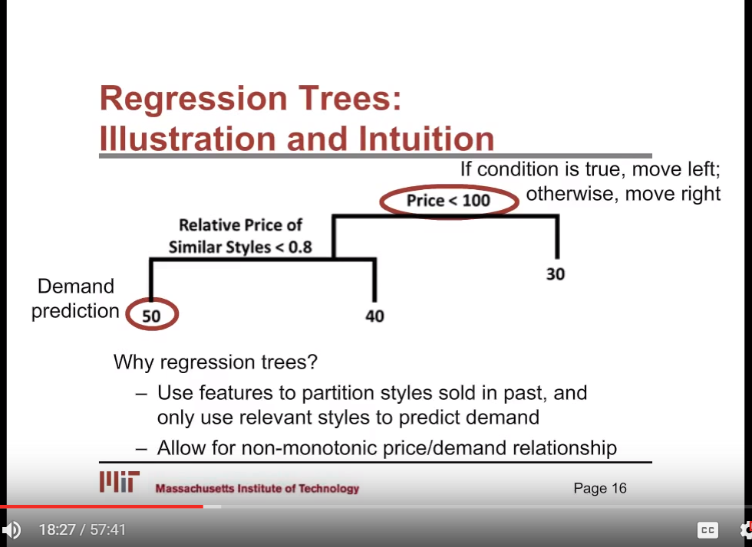
Source for this section, Talk by David Simchi-Levi https://www.youtube.com/watch?v=n1upFDGRdfc

Slide 32
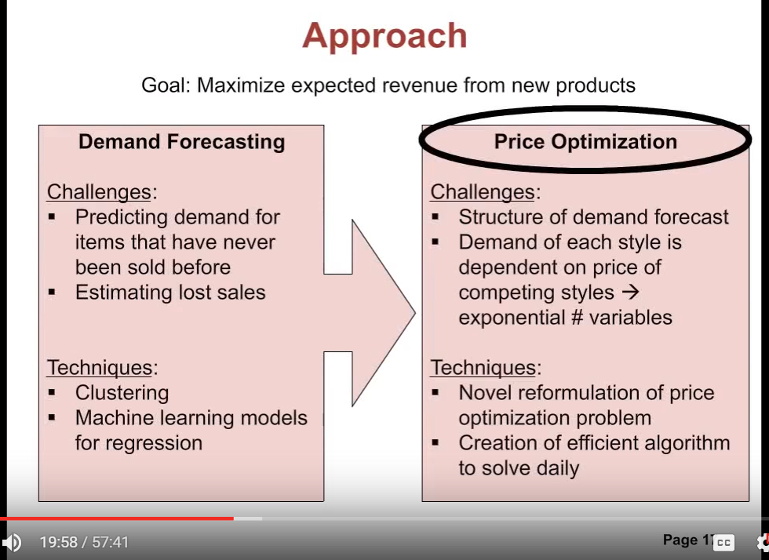
Source for this section, Talk by David Simchi-Levi https://www.youtube.com/watch?v=n1upFDGRdfc

Slide 33
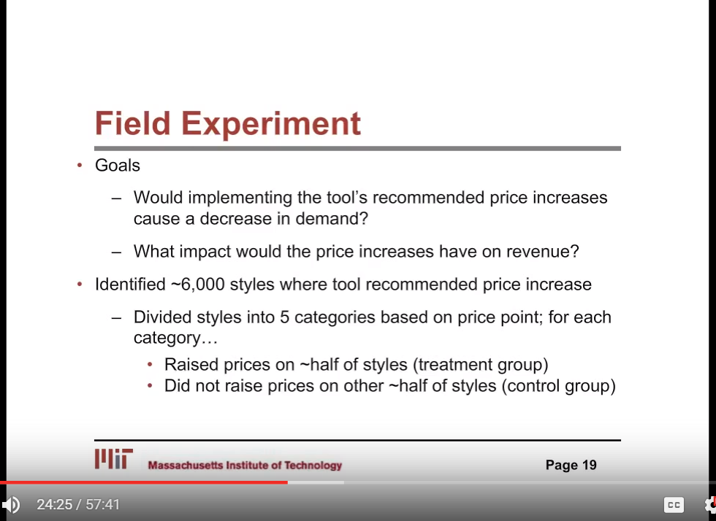
Also, worried about market share
Source for this section, Talk by David Simchi-Levi https://www.youtube.com/watch?v=n1upFDGRdfc

Slide 34
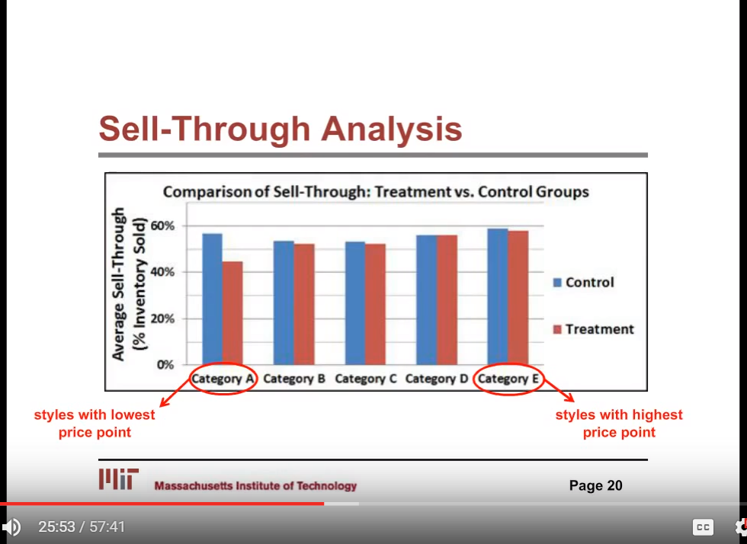
Source for this section, Talk by David Simchi-Levi https://www.youtube.com/watch?v=n1upFDGRdfc

Slide 35
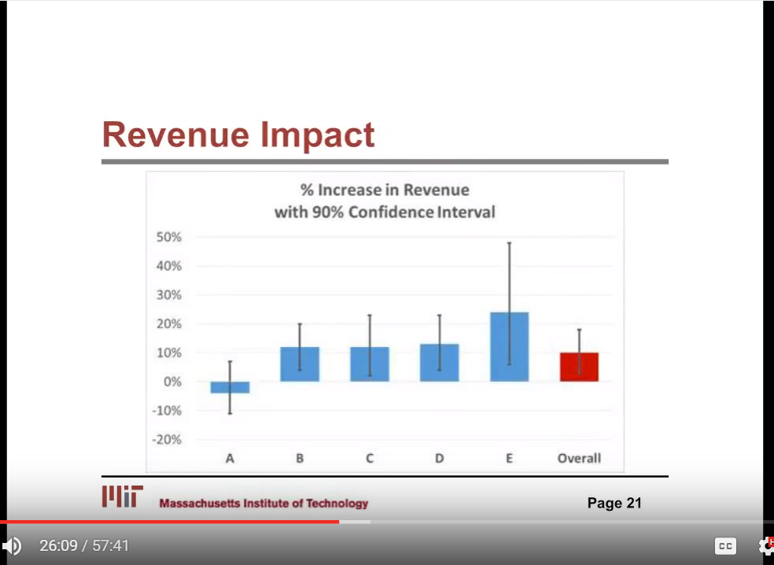
Source for this section, Talk by David Simchi-Levi https://www.youtube.com/watch?v=n1upFDGRdfc

Slide 36
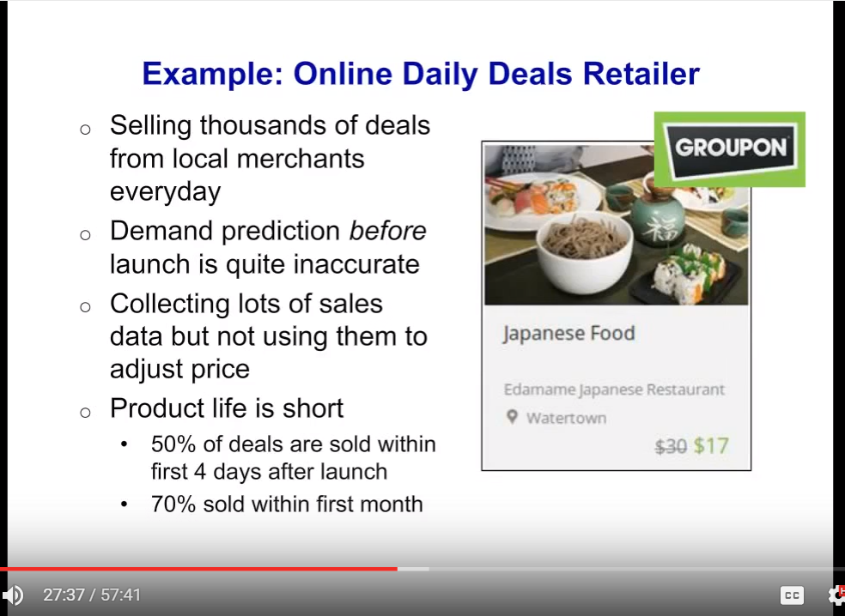
Merchant gets fixed amount here. If price goes down, Groupon takes that hit.
Source for this section, Talk by David Simchi-Levi https://www.youtube.com/watch?v=n1upFDGRdfc

Slide 37
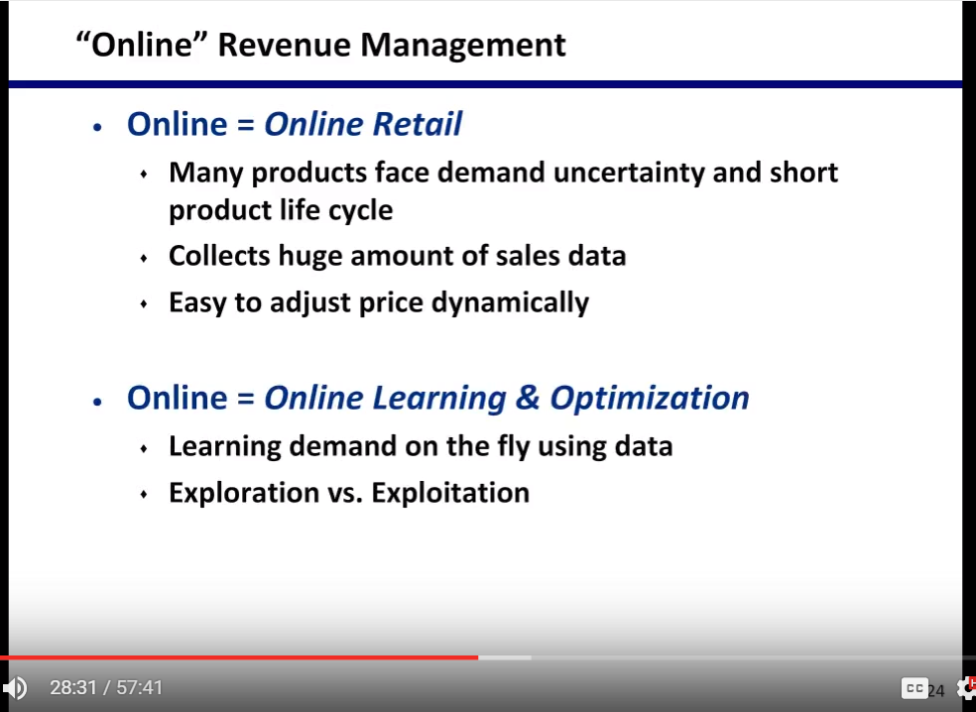
Source for this section, Talk by David Simchi-Levi https://www.youtube.com/watch?v=n1upFDGRdfc

Slide 38
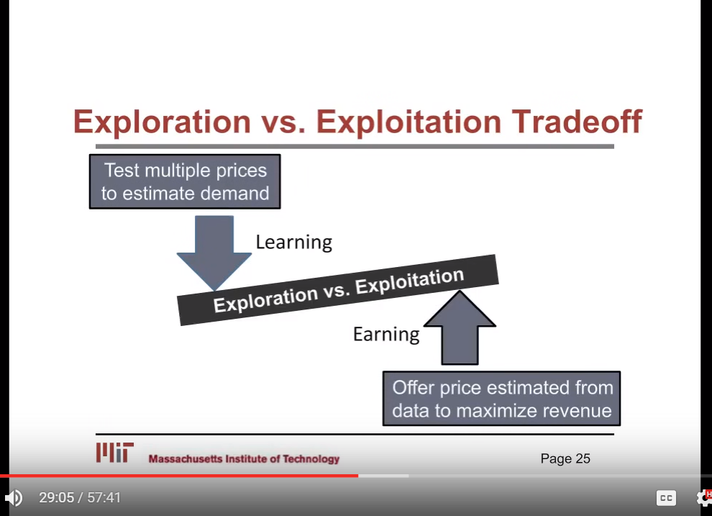
Source for this section, Talk by David Simchi-Levi https://www.youtube.com/watch?v=n1upFDGRdfc

Slide 39
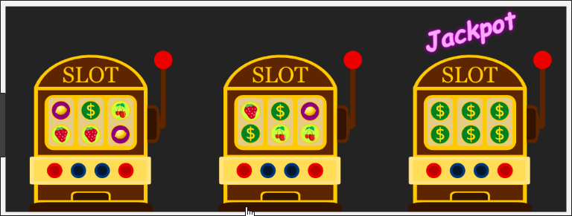
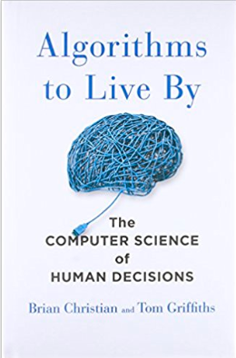
Explore vs Exploit
The Multi-Armed Bandit Problem
You don’t the know the win probabilities ahead of time
You have to explore each one to get a sense of the win probabilities
At some point, you want to play the best one with the limited data. This is exploiting

Slide 40
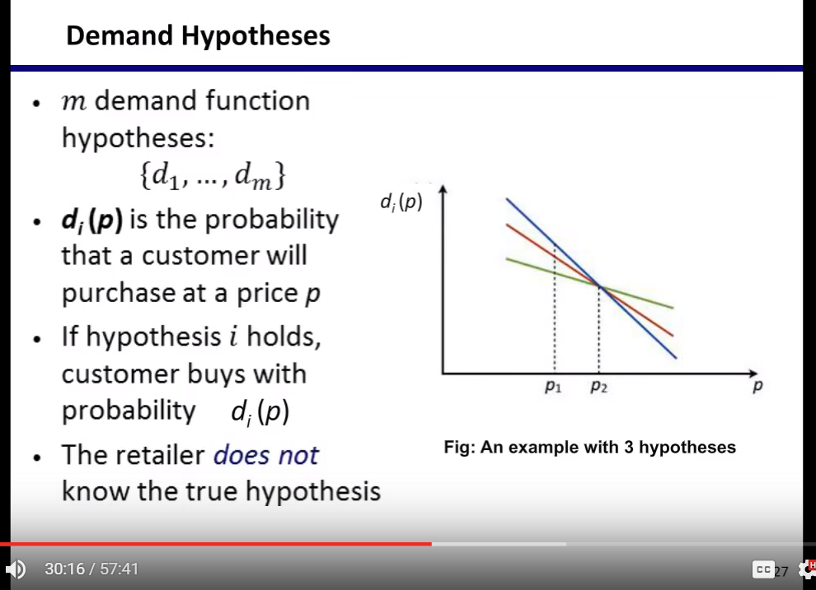
Source for this section, Talk by David Simchi-Levi https://www.youtube.com/watch?v=n1upFDGRdfc

Slide 41
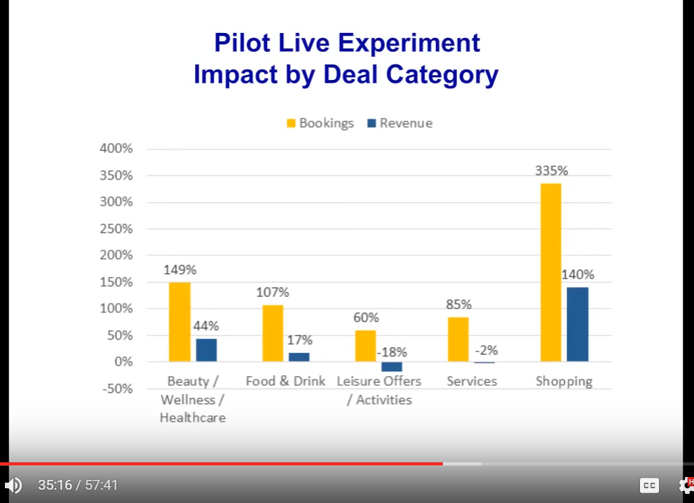
Bookings = total revenue (shows market share)
Revenue = what Groupon gets
Source for this section, Talk by David Simchi-Levi https://www.youtube.com/watch?v=n1upFDGRdfc

Slide 42
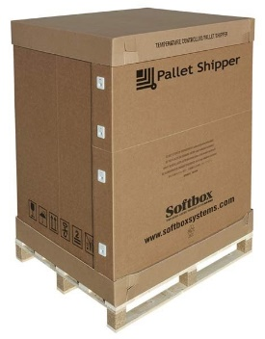
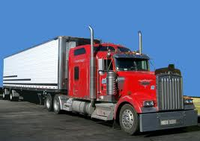

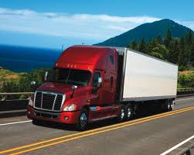

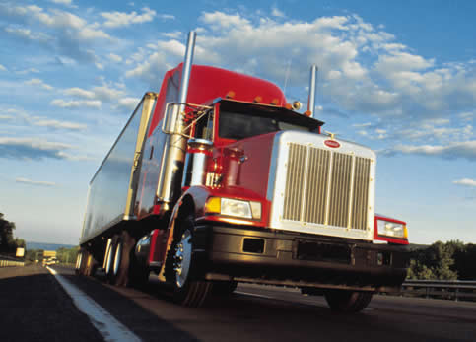
Logistic Regression Applications: 3PL Broker
Quote?

Slide 43
Logistic Regression Applications: 3PL Broker
While on a call provide a quote to customer
Too high
Shipper hangs up
Too low
Shipment accepted by the shipper
Cannot source it profitably
Not easy to find the right quote
Shipper accepts the quote
Can be cheaply sourced

Slide 44
Logistic Regression Applications: 3PL Broker
Historical shipments and sourcing data
Truck positioning
Batch loading
Weekly calibrate an acceptance model
Logistic Regression helps determine probability of accepting or rejecting a bid
In real time while on the call
Solve a small optimization model
Finds quote
Uses acceptance models

Slide 45
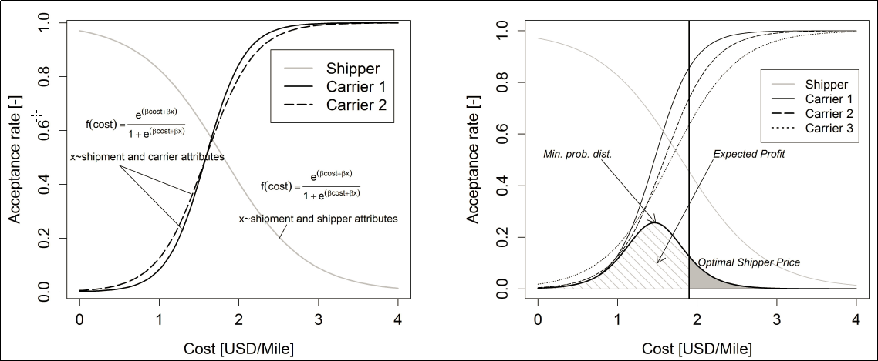
Logistic Regression Applications: 3PL Broker– What solution looks like
Source:Online pricing and capacity sourcing for third-party logistics providers
C. Lindseya, A. Freia, H. S. Mahmassania,*, H. Alibabaia, Y.W. Parkb, D. Klabjanb, M. Reedc, G., Langheimc, T. Keatingc

Slide 46


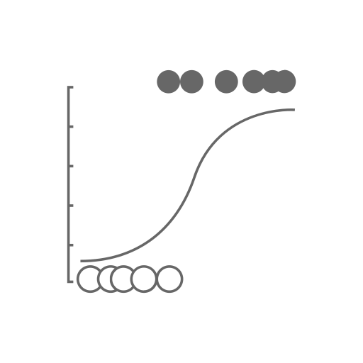
Translating Logistic Regression to a MIP
But, that information is useless without knowing the capacity of the mines, the costs of the mines, and transportation costs.
ML can predict the likelihood you’ll win a bid at a given price…
Optimization makes predictions valuable– what should they bid to maximize profits and respect constraints?

Slide 47
Translating Logistic Regression to a MIP
Not worth it to build a non-linear model:
Too many other constraints (a big network flow model)
Curves are estimates

Slide 48
Translating Logistic Regression to a MIP
x
x
Instead, pick discrete points on the curve and set as binary variables (the points on the curve represent the PricePoint and ProbabilityOfWin
PricePointPicked [i,j] = 1, if the j^{th} price point is picked for the i^{th} bid. Each of the i bids has j different prices.
Sum over j for each i = 1 (you pick only 1 price)
Then, Demand[i] * PricePointPicked [i,j]*ProbabilityOfWin[i,j] = ExpectedDemand
The same with expected revenue…
Of course, the network model is quite complex (but this is the start)
x
x
x
x

Slide 49
Revenue Management
Pricing tools– how does demand change with prices
Forecasting tools– what is the expected demand
Inventory tools– how much inventory to make available
Yield management– how much to allocate to different groups (this is what you did in Game 3)

Slide 50
What Industry Characteristics Would Make Yield Management Work?
Expensive or impossible to store inventory
Commitments need to be made when future demand is uncertain (set aside capacity for future demand)
Can differentiate among customers
The same unit of capacity can satisfy many types of demand
Producers are profit-oriented and have broad freedom of action

Slide 51
Other Examples of Yield Management
Manufacturing Capacity
Advertising space (on-line, in print, on TV)– like NBC deciding how much to make available upfront vs later
Hotels
Airlines
Cruise Ships
Manufacturing with tight and valuable capacity
Sporting events, concerts, shows, etc

Slide 52
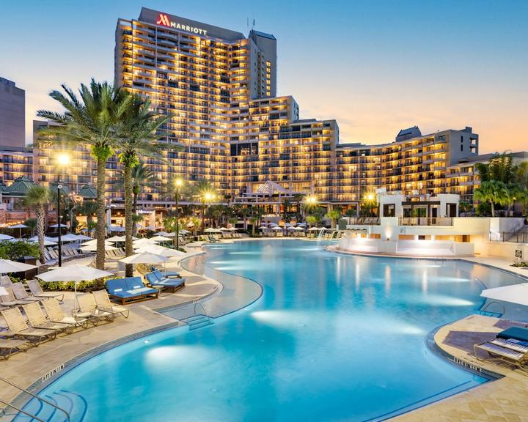
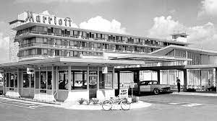
Marriott- early yield management
Optimal price for hotel rooms
Conference facilities and catering
Strong customer loyalty to retain the best customers
Expanded to their offering to property owners
$100M in additional revenues
Revenue Management at first hotel
When close to full, look out the window, if there are less than 4 people in the car, say “no”

Slide 53
Background You Should Know: Newsvendor Model

Slide 54
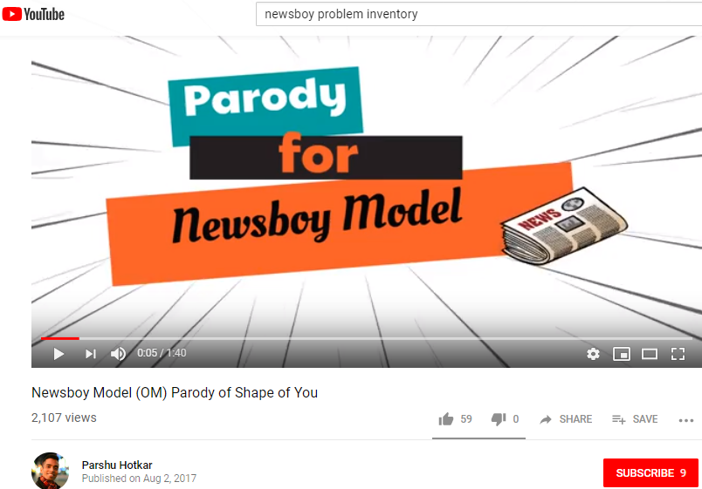
If you like to learn through corny song parodies, this might be the nerdiest thing you watch this Quarter…
Views as of 2:41pm CT, 4/4/19: 2,124
4:38pm CT on 9/5/22: 5,546
12:55pm CT on 10/30/22: 5.6K
Source: https://youtu.be/1T12i5Jgv80

Slide 55
News Vendor Model
Simple model that incorporates demand variability
Meant to address the question of how many do I produce (or buy) given that I only have one chance to make the decision before demand is realized
The demand is variable--- we don’t know its actual value before we produce (or buy) the products

Slide 56
News Vendor Model
One period model
You order your products, the products arrive, and then you experience demand
If you have extra products at the end of the period you pay a penalty
You have to scrap or sell at a reduced price
If demand is greater than the number of products you ordered, then you pay a penalty
Lost sales (lost profit), lost goodwill, maybe a monetary penalty
Demand is variable
And, for computational purposes, demand is assumed to be normally distributed
What industries does this model apply to?
Fashion, perishable, high tech, seasonal

Slide 57
News Vendor Model: Notation
X = demand for the period, this is a random variable
G(x) = cumulative distribution function, it represents the probability that X is less than or equal to x.
D_{a} = Average demand (average over all possible values for X)
D_{s} = Standard deviation of demand
c_{o} = cost (in dollars) per unit left over
c_{s} = cost (in dollars) per unit shortage
Q* = The optimal order quantity (in units). The decision variable

Slide 58
News Vendor Model: What Can Happen
x₁
If actual demand is higher than Q, you lose sales
All Possible
Outcomes
for Demand
Q-- the amount you order
If actual demand is lower than Q, you have excess inventory
x₀

Slide 59
The Optimal Q
In General
News Vendor Model’s critical ratio
c_{s}
G(Q*) =
c_{o} + c_{s}
For Normal Distribution
Q*- D_{a}
c_{s}
Φ(
) =
D_{s}
c_{o} + c_{s}
To solve:
1. Solve right hand side of equation
2. Using number from step 1, look up value in standard
normal table
3. Solve value inside of parenthesis for value found in step #2

Slide 60
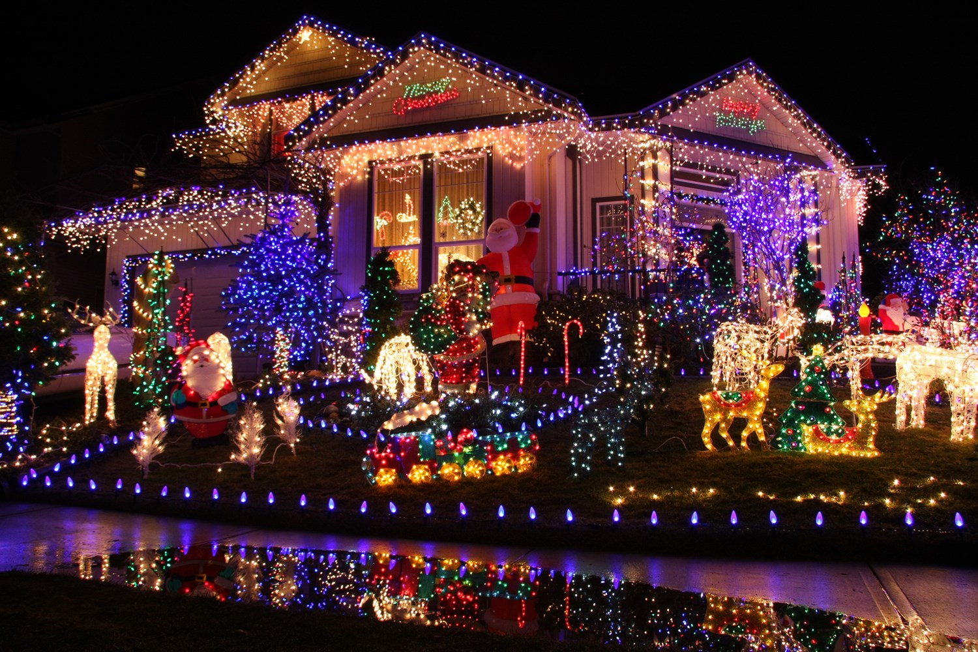
Christmas Light Example
Expected demand is 10,000
Standard deviation is 1,000
It costs you $1 to buy a unit of lights
You sell for $2
At the end of the season, you can sell for $0.50
How many Christmas Lights should you buy?
If you go to the simulation, can you beat your number?
What does this tell you about this type of optimization?
What if the variability was 3,000 and not 1,000?
What if you sold for $1.50 and they had no resell value?

Slide 61
Newsvendor for Revenue Management

Slide 62
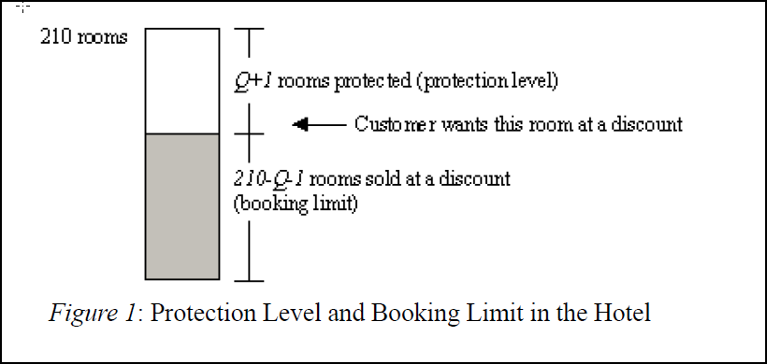
Hotel Revenue Management
Hotel has 210 rooms available for March 29
Two classes of customers
Leisure: $105
Business: $159

Slide 63
How do you create “barriers” or “fences” between customers?
Hotel: Book early
Applies to other industries as well.
What else?
Weekend stays
Length of contract
Slightly different products or services (software companies charging different maintenance for 5 X 8, 5 x 24 and 7 x 24 service)
Different channels (outlets, on-line, store, 3rd party)
….

Slide 64
How Many Rooms Do You Protect?
How many rooms would you protect? (save for the business traveler). This is the protection level
The amount of rooms you offer the leisure travelers is the booking limit
Booking Limit = 1 – Protection Level (in this case)

Slide 65
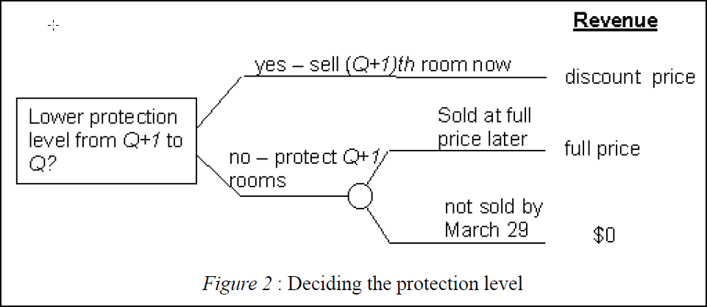
How to Think About the Optimization Problem
What does this depend on?
Difference in price and chance of selling out

Slide 66
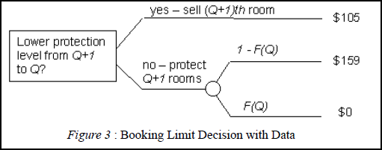


How to Think About the Optimization Problem
Expected Value of protecting Q+1 Rooms
To lower to Q (and sell 1 more discounted room), we need to ensure that the expected value of Q+1 is less than $105
=
Note: There is a missing equal sign in the paper

Slide 67

Cumulative Demand Table- Demand At Full Rate

Slide 68

Solving The Hotel Problem
We now scan from the top of the table down until we find the first value with a cumulative probability greater than 0.339
Levels
Protection = 79
Booking Limit= 210-79 = 131

Slide 69
Solving The Hotel Problem- more insight
“Critical Ratio”
Expected Value of Q+1 Rooms
Levels
Protection = 79
Booking Limit= 210-79 = 131
If we lower to 78 (sell another discount room) …
(1-F(78)*159 = (1-.285)*159 = 113 (which is better than 105) (this is the expected value of selling the 78th room, so you still could sell 1 more and be better than 105)
If we raise it to 80 (and try to sell another business room)…
(1-F(80)*159 = (1-.374)*159 = 99.53 (which is worse than $105)

Slide 70


The General Problem: Expected Marginal Seat Revenue (EMSR)
This problem generalizes to the newsvendor problem
We start with our critical ratio
B = H-L (what you lose by not selling the high price room)
C = L (what you lose by not selling at the low price
Note that the formula at the top, the order the that values are entered for the denominator is reversed
Solve this like the newsvendor model
C- overage penalty (what you could have received from selling low price)
B- Underage penalty (extra lost by not selling a high price room)
r-H and r-L are the High and Low price

Slide 71
Overbooking
Let’s say this hotel has the following no-shows:
Average: 20
Standard dev: 10
Assume normal distribution
If they overbook – what is C (overage penalty) and B (underage penalty)?
It costs them $300 to bump someone
They gain additional $105 (they would have at least gotten this)
C- overage penalty (In this case, the penalty is $300, why?)
B- Underage penalty (in this case, it is $105, the cost of leisure room, why?)

Slide 72


Solving Overbooking
=NORMINV(0.2592,20,10) = 13.5 , (we round to 13 or 14)

Slide 73


Early Version of Revenue Management: Littlewood’s Rule
Two seat class model, with an overall capacity
https://en.wikipedia.org/wiki/Littlewood%27s_rule

Slide 74

Revenue Management at American Airlines
Effective use of seat inventory is critical
Once a plane leaves, the empty seat is economically useless
American Airlines has been studying and optimizing this problem since the 1960’s
Saved $1.4B in three years up to 1992 and expect $500M to continue into the future
Not clear if an airline can survive without this capability
Many carriers went out of business when American implemented this system, picking off the low fare customers while maintaining the high revenue customers
Huge optimization problem
(Must be split up)

Slide 75
Components of Airline Revenue Management
Overbooking
Determining the number of extra seats to actually sell
Typically, 50% of all reservations are no-shows or cancellations
Without overbooking, 15% of seats would be empty, versus 3% (older data)
Discount Allocation
Determining how many discount fares to offer
Trading off filling up the plane versus waiting for the last minute for the high-paying customers
Traffic Management
Managing the hub and spoke system

Slide 76


Changing Economics of Overbooking
Costs may be higher than you think….
Even without this, overbooking was losing out– cancellation fees can make the airline care a little less if you show up.

Slide 77
Implementing at American Airlines– Highly Automated System and Part of IT Strategy
Requires a detailed system to track seats available at any point in time
Must be able to handle 50,000 price changes a day
Must make most decisions automatically, flagging only the exceptions

Slide 78
Let’s Explore How the Yield Management Optimization Problem Works For an Airline
Simple model: 3 time periods, high payers come later, focus on one class of travelers (coach) with a known number of seats
Key inputs
Expected sales at a given price for a given time period (a demand curve)
Key decision variable and what these decision variables do
Prices for period 1, 2, and 3 (all picked at the same time)
The price for period 1 should sell some seats, leaving enough for periods 2 and 3 and so on….
How do you implement– what do you do at the end of period 1?
Determine seats available, and then pick the new prices for periods 2 and 3
What makes it harder
We have different probabilities for different demands
More than 3 time periods
We can change the number of seats we offer on a leg (at a cost)
We have different types of seats (First, Business, Coach)

Slide 79
…The Other Side of Airline Pricing
Farecast (was part of Bing, Microsoft shut down the service)
Collected airfare rates over time for different legs
Built predictive models to determine if a price was likely to increase or decrease over time
Told the consumer if they should buy or wait
Claimed to be correct 75% of the time
The book didn’t say, but how would the airlines react?
Source: Big Data: A Revolution That Will Transform How We Live, Work, and Think
By Viktor Mayer-Schonberger, Kenneth Niel Cukier

Slide 80

Harrah’s– Another Example Of a Company Excelling at Analytics
Detailed use of the Loyalty Card program
Marketing
Reservations
Real-time decisions when you are on a losing streak

Slide 81

Example of Revenue Management at a Harrah’s Hotel
When booking a hotel room, what potential revenue number should Harrah’s use?
Net amount the customer spends on gambling
In what way are the interests of the best customers aligned with the interest of Harrah’s?
Biggest spenders want the best offers--- Harrah’s
How do they do it?
Segment the customers into expected profitability
Forecast demand by segment
Reserve enough rooms for the highest segment customers
Buy nearby rooms for other customers (as needed), if their expected profit exceeds the cost of the room

Slide 82
End of Section

